Slide 1





HackOrbit 2025
team : STRANGER STRINGS

Slide 2

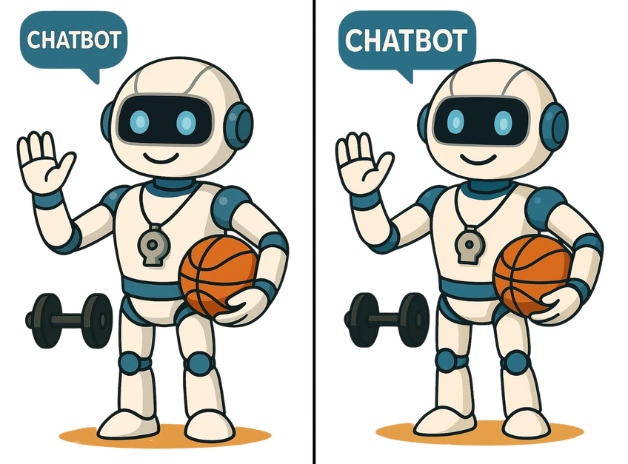
THEME & PROBLEM STATEMENT
Athletes often face difficulty finding personalized, sport-specific guidance that integrates training, nutrition, and competition planning in a single platform.
Human coaches charge excessive fees and are not affordable.
Existing coaching solutions are fragmented, players need multiple apps to cover each need.
SporifAI
There’s no all-in-one smart platform for athletes that offers:
Customized drills for each sport
AI-based posture and form feedback
Injury risk alerts
Personalized diet and nutrition plans
Scout connections for career growth
Smart schedule for events and rest days

Slide 3
PROPOSED SOLUTION
Sportif-AI addresses this challenge with an integrated, intelligent platform that offers:
AI Coach – Delivers real-time technique correction and dynamically adapts training plans based on performance and progress.
AI Dietician – Provides personalized, sport-specific nutrition plans aligned with the athlete’s goals and training intensity.
Smart Calendar – Automates scheduling for training, rest, and competitions while offering insights through performance analytics.
Athlete Profile Builder – Creates verified performance profiles to connect athletes with scouts and career opportunities.
Affordable personalized and professional training than human coaches.

Slide 4
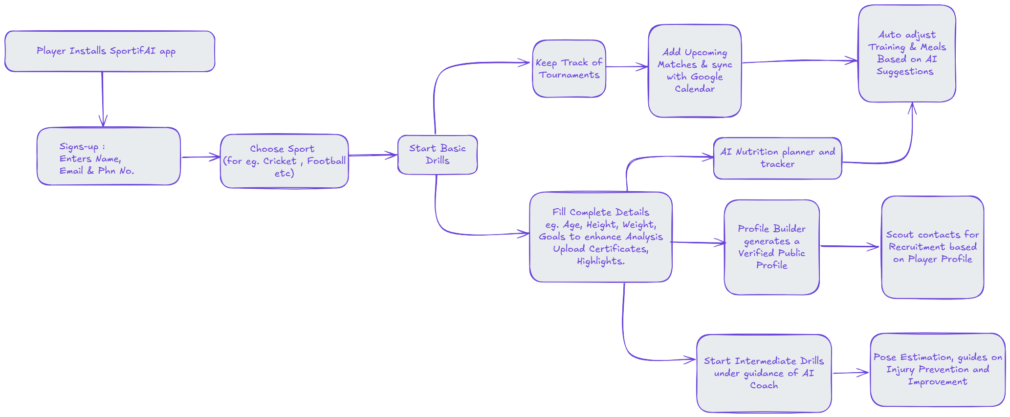
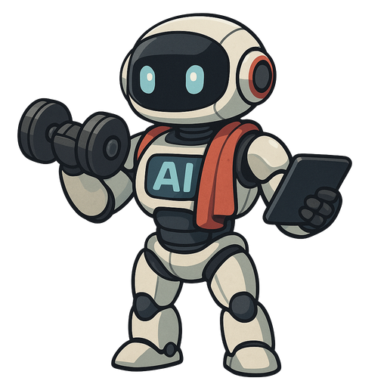
flowchart

Slide 5
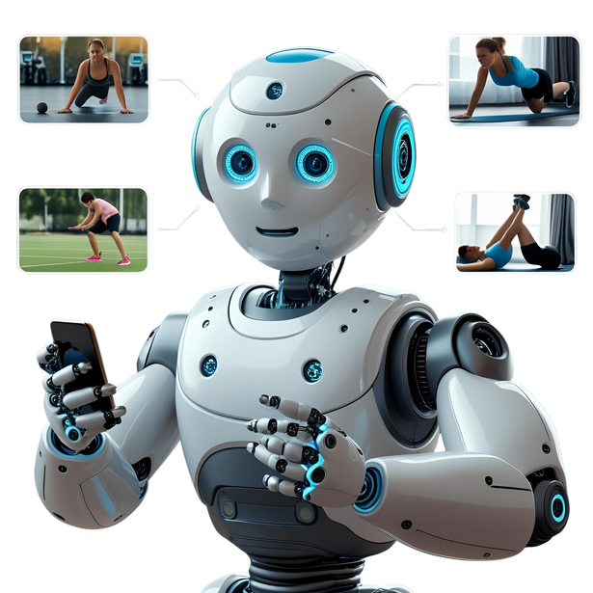


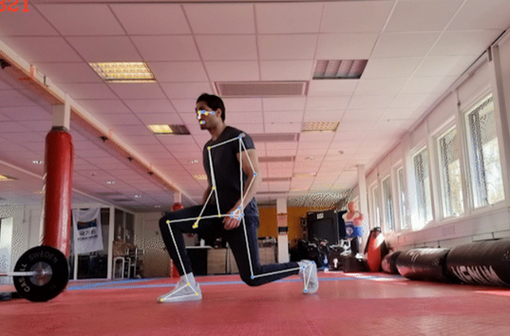

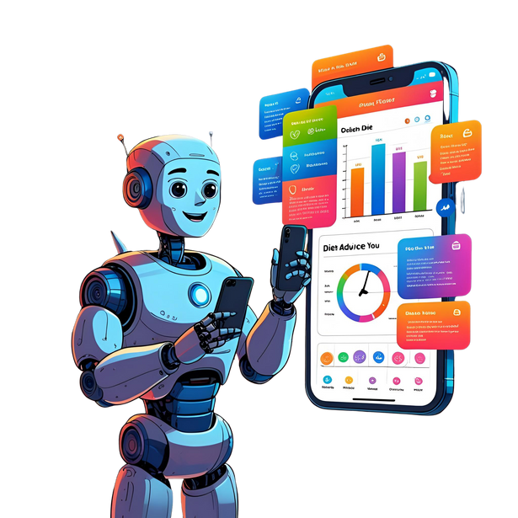





USECASE DIAGRAM
Player Registers on SportsAI
Player chooses the sport, enters his playing positions
Player starts Basic Drills and Training using SportAI Computer Vision
AI Coach analyses Pose, guides on Injury Prevention and Improvement
Player fills complete details (Age, Height, Weight, Goals)
AI dietician plans a calorie deficit for the player according to his requirements and choices
Opens Tournament Schedular/syncs with Google Calendar to keep a track of all upcoming tournaments
AI Buddy schedules pre tournament trainings and meals
Player enters his Certificates & highlights,
Profile builder builds his verified profile
Scouts can check multiple profiles
which are public to recruit a player.

Slide 6
FEATURES AND NOVELTY
1. Personalized AI Coach
Personalized workouts, training sessions according to body type and future goals
Injury prevention tips
Real-time form correction via pose estimation
2. AI Dietician
Sport-specific, adaptive meal plans
Meal scan for macros + hydration alerts
3. Tournament Tracker
Smart training schedule synced with calendar
4. Scout Connections
Make player profiles, upload qualification details & certifications
Upload videos/stats for scout visibility
Filter-based scout matching + direct chat
TECH STACKS
Flutter - App Development
Media Pipe - Pose Detection while training
OpenCV - Frames Extraction and video processing
Tensor flow - Form analysis
Firebase - Authentication
Node.js - Backend
MongoDB - Database

Slide 7
sHOWSTOPPERS and drawbacks
SHOWSTOPPERS
DRAWBACKS
AI Coach for sport-specific guidance and personalized mentorship to enhance athletic performance.
Scout Connections for career advancement opportunities.
Needs strong internet for smooth performance
Good camera required for accurate tracking
Multiple users may reduce detection accuracy

Slide 8
STRANGER STRINGS
VARUN RAHATGAONKAR - +91 9372148550
TANAYA JAIN - +91 9594622999
ATHARVA PINGALE - +91 8329635392
ARNAV CHAUDHARY - +91 9856652652

Slide 9
Thank you

